Slide 1
Bucket Sort

Slide 2
Presented By
Malik AbuHurara (2022-CS-122)
Tayyaba Afzal(2022-CS-134)
Raveeha Mohsin(2022-CS-149)
Hadia Moosa(2022-CS-119)

Slide 3
What is BUCKET SORT?
Bucket Sort is a sorting algorithm that divides an array or list into a number of buckets. Each bucket is then sorted individually, either using a different sorting algorithm or recursively applying the bucket sort algorithm. Finally, the contents of the buckets are concatenated to produce the sorted output.

Slide 4

Usage of BUCKET SORT
Bucket sort is often used in applications where the input data is evenly distributed, such as sorting grades or test scores. It is also useful for sorting data that is not easily comparable, such as strings or objects.

Slide 5
Limitations of In-Place Sorting
In-place sorting algorithms are limited by the amount of memory available to the algorithm. These algorithms require that the input array be modified in place, without creating a copy of the input array. This can be problematic when the input array is very large or when the available memory is limited.

Slide 6
Algorithm of Bucket Sort
1. Create n empty buckets.
2. For each element x in the input array:
Determine the index of the bucket to which x belongs.
Insert x into the appropriate bucket.
3. Sort each non-empty bucket individually (using another sorting algorithm or recursively using bucket sort).
4. Concatenate the sorted buckets in order.

Slide 7
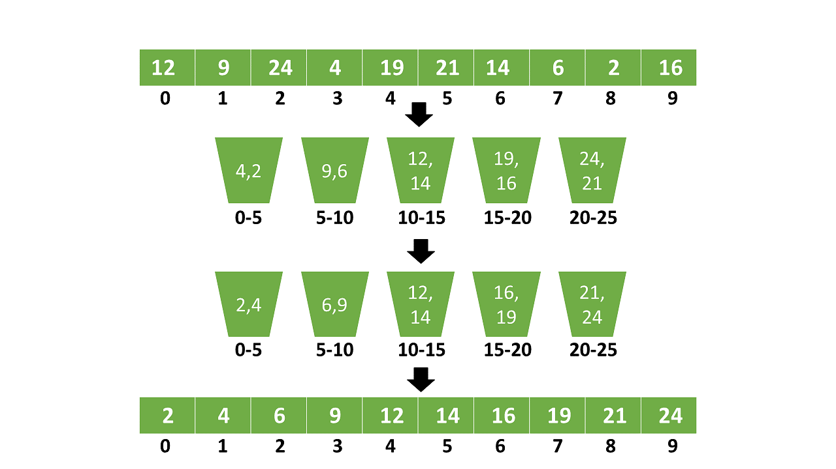

Slide 8
PSEUDOCODE
function bucketSort(array: list of sortable items)
create n empty buckets
for each item in array do
insert item into bucket[n*item]
for each bucket in buckets do
sort bucket
concatenate the sorted buckets
end function

Slide 9
Code in C++
void bucketSort(vector<int>& arr, int minVal, int maxVal, int bucketSize)
{ int n = arr.size(); // Calculate the number of buckets needed
int numBuckets = (maxVal - minVal) / bucketSize + 1; // Create an array of vectors to represent buckets
vector<vector<int>> buckets(numBuckets); // Place each element in its respective bucket
for (int i = 0; i < n; i++)
{ int bucketIndex = (arr[i] - minVal) / bucketSize; buckets[bucketIndex].push_back(arr[i]); } // Sort each bucket using std::sort
for (int i = 0; i < numBuckets; i++)
{ sort(buckets[i].begin(), buckets[i].end()); } // Concatenate the sorted buckets to get the final sorted array I
nt index = 0;
for (int i = 0; i < numBuckets; i++)
{ for (int j = 0; j < buckets[i].size(); j++)
{ arr[index++] = buckets[i][j]; } }}

Slide 10
Real-Life Examples
Bucket sort is a useful algorithm for sorting elements with uniformly distributed values. Here are some real-life examples where bucket sort can be applied:
Sorting students based on their grades in a class with a large number of students.
Sorting employees based on their salaries in a company with a large number of employees.
Sorting products based on their prices in an e-commerce website with a large number of products.

Slide 11
Time Complexity Analysis
Best Case
The best case time complexity for bucket sort is O(n+k), where n is the number of elements in the input array and k is the number of buckets used for sorting.
Worst Case
The worst case time complexity for bucket sort is O(n^2), which occurs when all the elements are placed in the same bucket.
Average Case
The average case time complexity for bucket sort is O(n+k), which is the same as the best case time complexity.

Slide 12
Conclusion
In conclusion, Bucket Sort is a highly efficient sorting algorithm that can be used to sort a large number of elements in linear time. It is particularly useful when dealing with uniformly distributed data or data that has a known range.

